Slide 1
Credit Data discovery & analysis
Shubham gaur
Harinandan Praveen
Rabiya Khatun
Attah Hussain Mohammed

Slide 2
Problem statement
Bank
Applicants
Refused
Unused offer
Client with payment difficulties
All other cases
Approved
Cancelled
Bank receives tons of applications for various kinds of loans
Applicants include people applying loan for the first time and people with historical data
With historical data, we can identify clients with payment difficulties and all other cases where there is no default in payment
Each loan request can have one of the following outcomes: Approved, Cancelled, Refused, Unused offer
As Data Analyst, we have to identify patterns in the available data to ensure that deserving clients have their loans approved and defaulter clients are refused so that businesses do not suffer any losses

Slide 3
assumptions
For Gender, since XNA category is less, we have assumed the data to be ‘F’ as number of F is higher than M
For organization type, we have assumed that 18% of data will not impact the final outcome

Slide 4
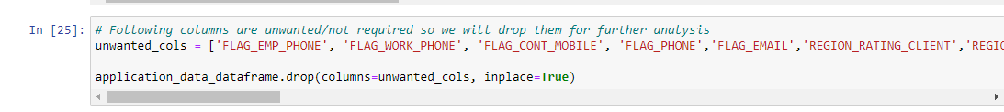
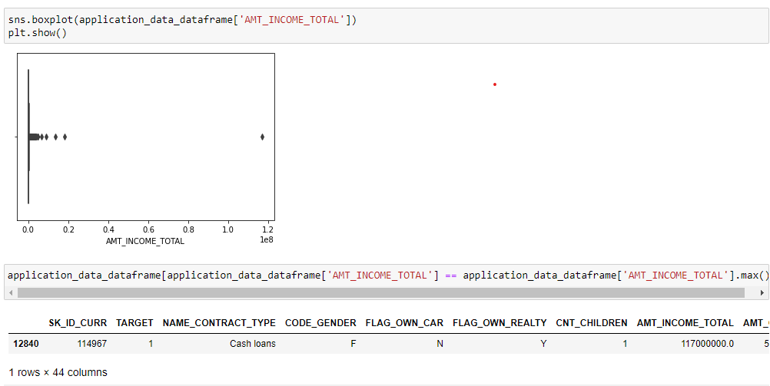
Overall approach
For unwanted columns
We have dropped unwanted data columns that will not impact our analysis
For missing data in columns
We imputed ‘XNA’ as ‘F’ in ‘CODE_GENDER’ category since ‘F’ is the most popular category in the dataset
We have 18% value marked as ‘XNA’ in ‘Organization_type’ category, since this percentage will not impact our computations, we have dropped them from our analysis
Data outliers
We have identified the multiple outliers using Univariate analysis, one of them is in Amt_Income_Total category

Slide 5
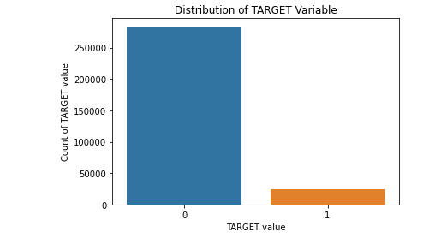
Overall approach
Data Imbalance
The given data is highly imbalanced with 92% clients as non defaulters and 8% as defaulters
The ratio of 0:1 is 10.54:1 This indicates for every 1 there are almost 11 no of 0's i.e. highly imbalanced data
Notes:
0 -> non-payment defaulter
1 -> payment defaulter
Out of 11 applicants 1 is payment defaulter

Slide 6
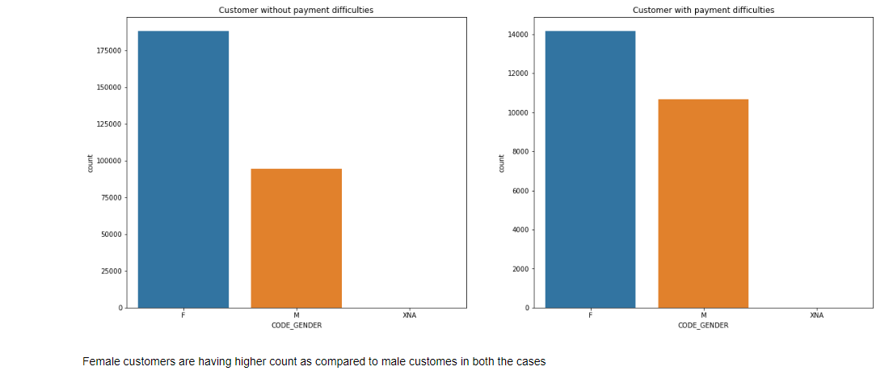
Univariate analysis
- In both cases, female clients are more likely to make payment defaults and all other cases
Notes:
Females are likely to make payment defaults in both category of applicants - The one with historic data as well as new cases

Slide 7
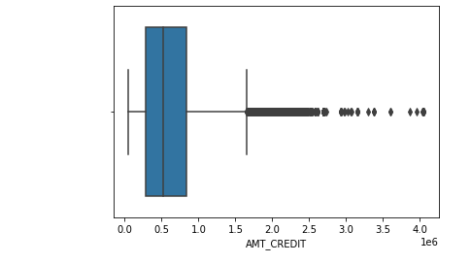
Box plot: amount credit
Few outliers noticed in the field
This means there have been few cases where Credit amount of the loan has been on the higher side and not close to median

Slide 8
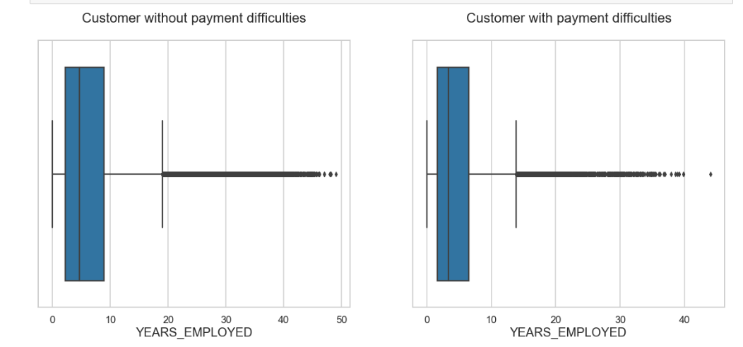
Box plot: years employed
Few outliers noticed in the field
Clients employed for higher years had less payment difficulties
Notes:
Employees with higher employment experience doesn’t face payment difficulties.

Slide 9
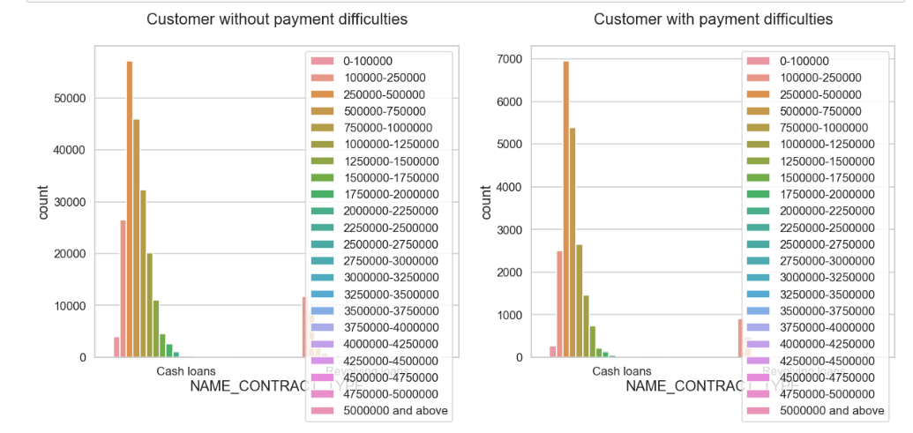
Bivariate analysis: countplot
- Maximum cash loans are given for the amount 250k-500k to clients who have no payment difficulties
- Maximum cash loans are given for the amount 250k-500k to client who have payment difficulties
- The number of clients who have received cash loans between 250k-500k are higher with no payment difficulties than the ones with payment difficulties

Slide 10
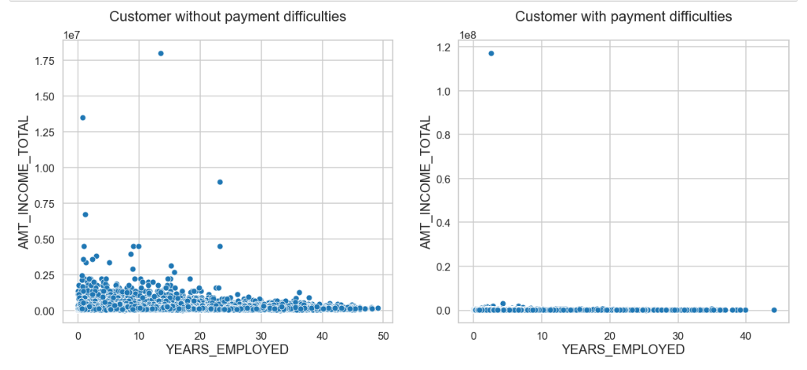
Bivariate analysis: scatter plot
There are outliers here
There is only 1 client with work experience less than 10 years and great income yet has payment difficulties
However, there is a majority of clients with work experience less than 10 years and great income with no payment difficulties
There are hardly any clients with more than 40 years of work experience and payment difficulties
Maximum loan defaulters come in the range of 0-10 years of work experience and less income

Slide 11
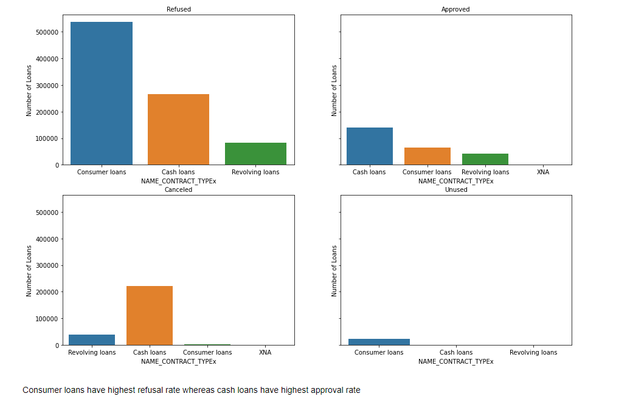
Bar graphs: merged data
Consumer loans have highest refusal rate whereas cash loans have highest approval rate
Cash loans are the highest to be cancelled

Slide 12
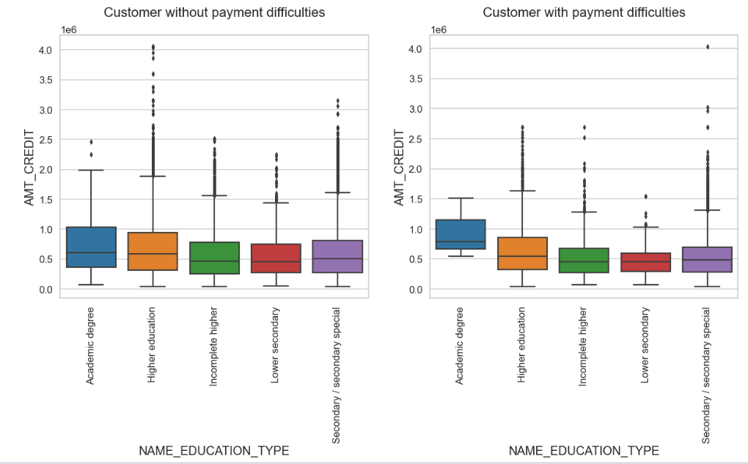
Bar graphs: merged data
Highest loan amount was credited to clients with higher education and had no payment difficulties
Clients with secondary/secondary special had payment difficulties and had high loan amount credited

Slide 13
conclusions
There are no payment difficulties observed when credited amount and price of goods are in the same range and hence banks should give loans that match with the price of goods
Maximum loan defaulters come in the range of 0-10 years of work experience and less income and hence this category should be avoided for loan approval
The number of clients who have received cash loans between 250k-500k are higher with no payment difficulties than the ones with payment difficulties. This is the average amount of cash loans that should be credited to clients
Clients employed for higher years had less payment difficulties and hence clients with more years of work experience should be given loan amount
Banks should focus more on contract type ‘Student’ ,’pensioner’ and ‘Businessman’ with housing ‘type other than ‘Co-op apartment’ for successful payments
Loan purpose ‘Repair’ is having higher number of unsuccessful payments on time.
Get as much as clients from housing type ‘With parents’ as they are having least number of unsuccessful payments

Slide 14


